Slide 1
The Millionaires Problem: An Intro to Conclave Development

Slide 2
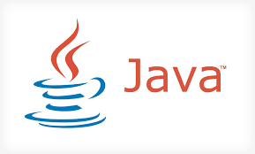
Summary
Purpose: The purpose of this document is to provide a simple guide for those looking to quickly get up and running with Conclave development.
Assumptions: This tutorial assumes the user has some familiarity with programming languages such as Java. For the purposes of this document, we assume the user is operating on a Mac or Windows machine.
Content: This document will provide an overview on how to develop Conclave applications. Conclave key concepts are covered in a separate lesson.
Goal: By the end of this tutorial you should have a basic understanding of how to create your own Conclave Applications.
Notes:
Architecture: Nodes, Notaries, Doorman Service and Oracles
UTXO Model Transactions, States and Flows
Business Networks and interoperability
Deployment and Hosting: on-prem vs. Cloud, (Azure, AWS, HP)
Security: Cryptography and immutability of records, P2P architecture
Performance considerations: Transactions per second, Consensus algorithms and Number of nodes per flow
Technology: Java, Kotline, JVM, AMQP over TLS, Pluggable databases

Slide 3
Content Overview
Part 1:
The Millionaire’s Problem
Part 2: Setting up your Machine
Part 3: Deploying an Enclave
Part 4: Source Code Review
Part 5: Lab
Notes:
Transaction model is highly flexible supporting arbitrary combinations of asset issuance and modifications – DvP, PvP etc
Flows automatically handle communication and persistence – can survive restarts, upgrades etc

Slide 4
The Millionaires Problem
1

Slide 5
The Millionaires Problem
We will be exploring a classic multi-party computation problem known as the Millionaires Problem or Yao’s Millionaires Problem.
It was developed by computational theorist Andrew Yao in 1982.
The problem discusses two millionaires, Alice and Bob, who would like to know which of them is richer, without revealing their actual wealth.
While Yao was able to solve for this problem with an exponential complexity, we will show how Conclave can solve for this far more efficiently.

Slide 6
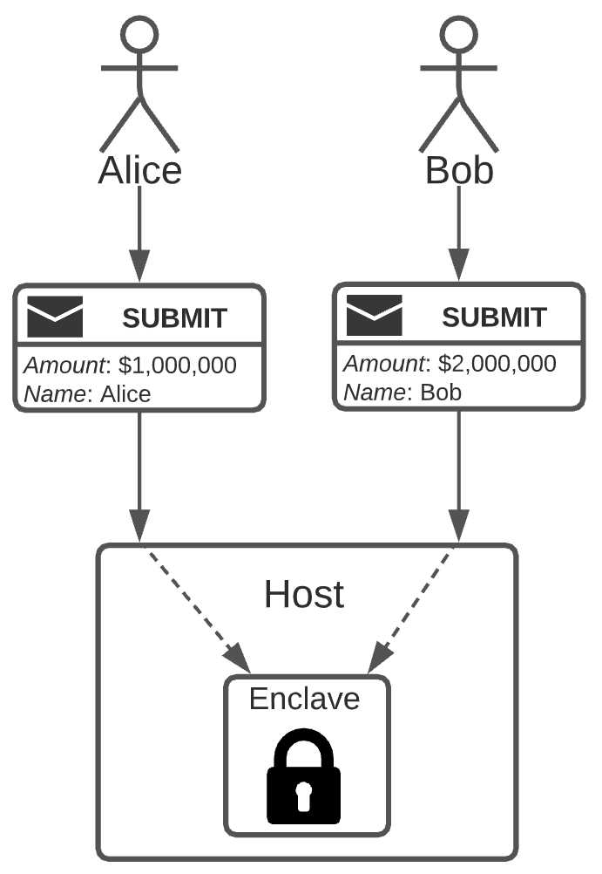
The Millionaires Problem
On the left we can see a diagram, showing the basic workflow for this use case in Conclave.
Alice submits an encrypted mail object containing her name and net worth. The host passes this mail to the Enclave which is decrypted and stored in memory.
Bob submits an encrypted mail object containing his name and net worth. The host passes this mail to the Enclave which is decrypted and stored in memory.
Once the Enclave receives two different submit messages, it will print the result of which net worth is larger.

Slide 7
Setting up your Machine
2

Slide 8
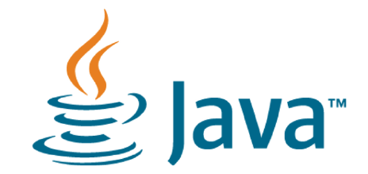
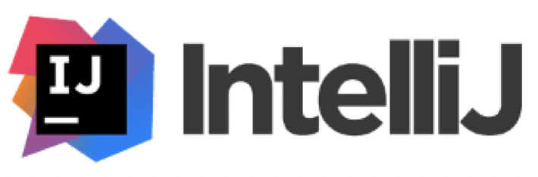
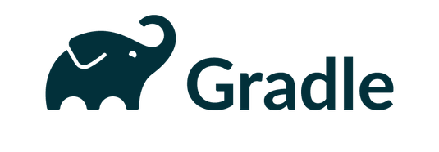
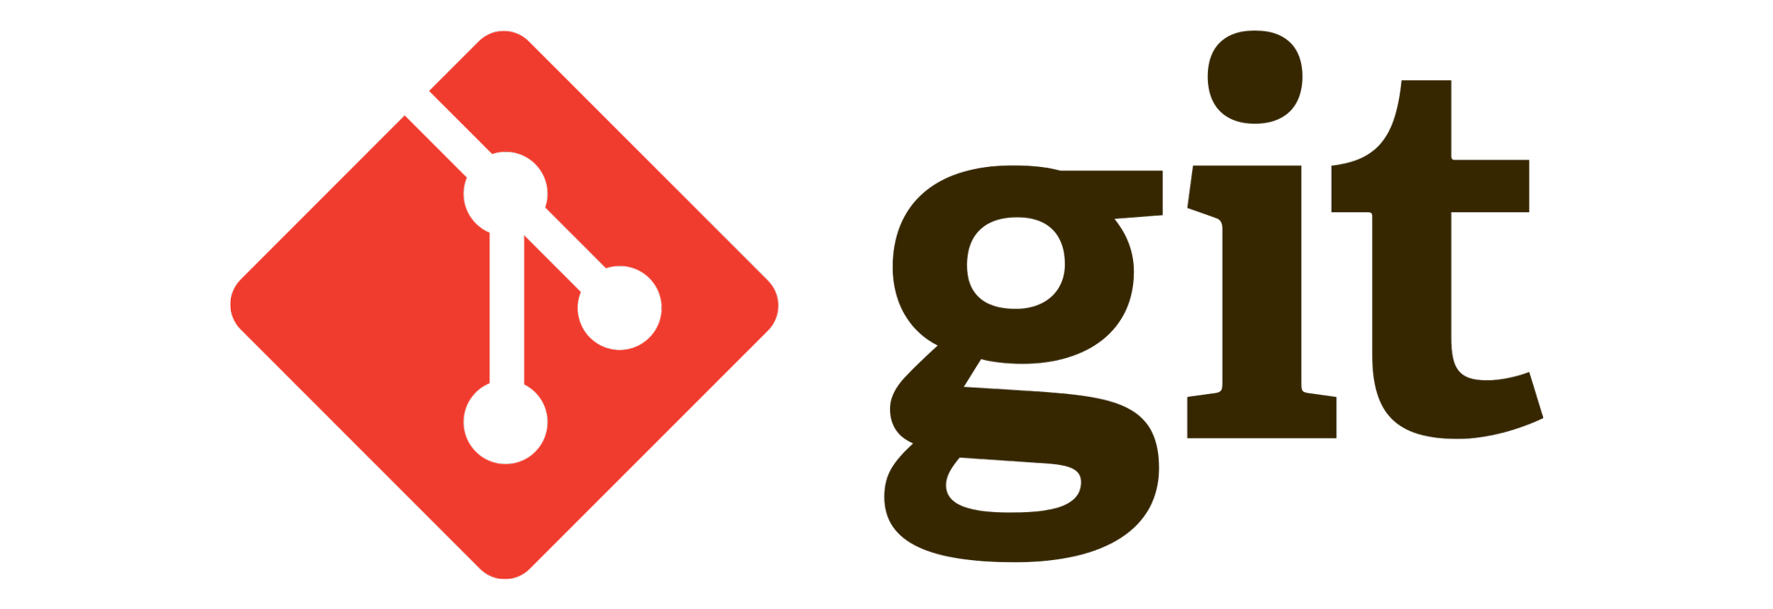
Key Technologies
In this document, we will outline the installation process behind each of these tools.
While it may help to have experience with some of these tools it isn’t a requirement.
If you already have these tools installed, feel free to skip this step.

Slide 9
Java
An Enclave can run any JVM based language such as Java or Kotlin but for the purposes of this tutorial we will be using Java.
Conclave supports Java versions 8 and 11 but we will be using Java 11 for this tutorial.
If you need to download or upgrade Java, navigate to the Java 11 JDK download page here.
Then click the appropriate download for your machine.
If you are not logged into an Oracle account, you may need to login or create an account for the download to begin.
Notes:
Architecture: Nodes, Notaries, Doorman Service and Oracles
UTXO Model Transactions, States and Flows
Business Networks and interoperability
Deployment and Hosting: on-prem vs. Cloud, (Azure, AWS, HP)
Security: Cryptography and immutability of records, P2P architecture
Performance considerations: Transactions per second, Consensus algorithms and Number of nodes per flow
Technology: Java, Kotline, JVM, AMQP over TLS, Pluggable databases

Slide 10
Gradle
Gradle is a tool that provides build automation for Applications and allows for the easy management of project dependencies.
If you are using a Mac machine, installation of Gradle is simplest through the package management software Homebrew. Simply run the following command to install the lasted version of gradle.
brew install gradle
Instructions for manual installation can be found here if you do not wish to use Homebrew or you are using a Windows machine.
Notes:
Architecture: Nodes, Notaries, Doorman Service and Oracles
UTXO Model Transactions, States and Flows
Business Networks and interoperability
Deployment and Hosting: on-prem vs. Cloud, (Azure, AWS, HP)
Security: Cryptography and immutability of records, P2P architecture
Performance considerations: Transactions per second, Consensus algorithms and Number of nodes per flow
Technology: Java, Kotline, JVM, AMQP over TLS, Pluggable databases

Slide 11
Git
Git is a version control tool for tracking changes in source code for software development.
If you are using a Mac, you can also install git using homebrew by using the following command.
brew install git
Instructions to download git without homebrew can be found here.
Later in this tutorial, we will use Git to access the Conclave application used in this tutorial.
Notes:
Architecture: Nodes, Notaries, Doorman Service and Oracles
UTXO Model Transactions, States and Flows
Business Networks and interoperability
Deployment and Hosting: on-prem vs. Cloud, (Azure, AWS, HP)
Security: Cryptography and immutability of records, P2P architecture
Performance considerations: Transactions per second, Consensus algorithms and Number of nodes per flow
Technology: Java, Kotline, JVM, AMQP over TLS, Pluggable databases

Slide 12
Docker
Docker is a containerization solution that can help with the process of developing, shipping and running applications.
If you are on a Linux machine, Docker is not actually required but for Mac or Windows it will be needed.
Instructions on how to install Docker can be found here.
Notes:
Architecture: Nodes, Notaries, Doorman Service and Oracles
UTXO Model Transactions, States and Flows
Business Networks and interoperability
Deployment and Hosting: on-prem vs. Cloud, (Azure, AWS, HP)
Security: Cryptography and immutability of records, P2P architecture
Performance considerations: Transactions per second, Consensus algorithms and Number of nodes per flow
Technology: Java, Kotline, JVM, AMQP over TLS, Pluggable databases

Slide 13
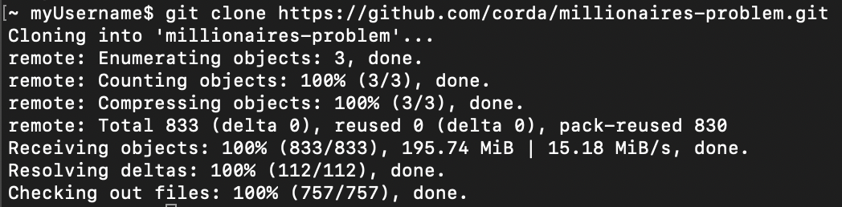
Download the Git Repository
The Git repository for this lesson can be found here: https://github.com/corda/millionaires-problem.
Open Terminal on your machine and navigate to the target directory where you wish the project to be located.
Next type git clone https://github.com/corda/millionaires-problem.git and hit enter.
You should see something similar to the image below.
Notes:
Architecture: Nodes, Notaries, Doorman Service and Oracles
UTXO Model Transactions, States and Flows
Business Networks and interoperability
Deployment and Hosting: on-prem vs. Cloud, (Azure, AWS, HP)
Security: Cryptography and immutability of records, P2P architecture
Performance considerations: Transactions per second, Consensus algorithms and Number of nodes per flow
Technology: Java, Kotline, JVM, AMQP over TLS, Pluggable databases

Slide 14
Deploying an Enclave
3

Slide 15
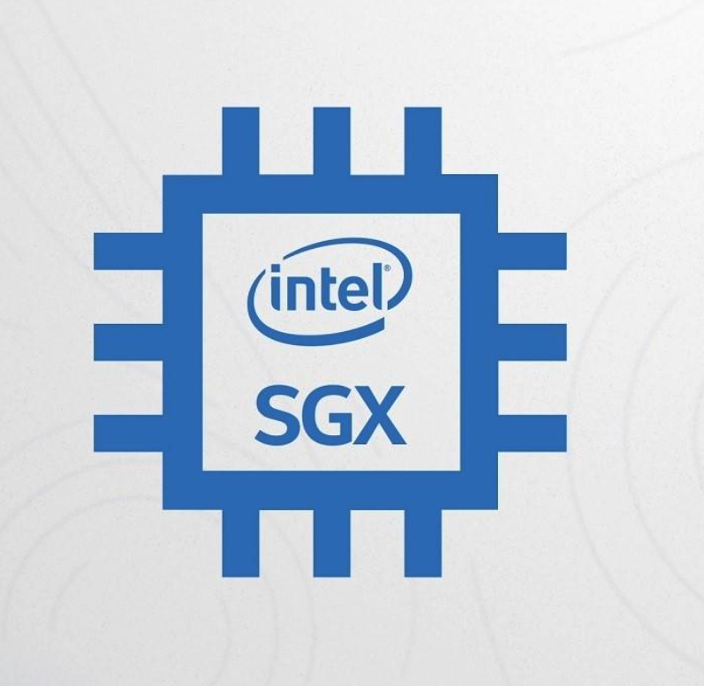
Deploying an Enclave
In this tutorial, we will stick to deploying the Enclave in simulation mode so we can test the functionality of our application.
Deploying an enclave in “release” mode on real Intel SGX hardware is a more complicated process that we won’t explore in this course.
More information on deploying an enclave on SGX hardware can be found here.
Notes:
Architecture: Nodes, Notaries, Doorman Service and Oracles
UTXO Model Transactions, States and Flows
Business Networks and interoperability
Deployment and Hosting: on-prem vs. Cloud, (Azure, AWS, HP)
Security: Cryptography and immutability of records, P2P architecture
Performance considerations: Transactions per second, Consensus algorithms and Number of nodes per flow
Technology: Java, Kotline, JVM, AMQP over TLS, Pluggable databases

Slide 16
Setting up your Docker container
First, we’ll need to setup the Docker container where the host & enclave will run.
Run the following steps in order.
docker run --name millionaires-problem -p 8080:8080 -it -d -v :/sdk -w /sdk ubuntu bash
This will create the docker container running on port 8080.
docker exec -ti millionaires-problem apt update
docker exec -ti millionaires-problem apt install -y openjdk-11-jdk
You will need to input your geographic region during this step.
To check that the docker container is running properly run the following command.
docker ps -a
You should see something similar to the snippet below.
Notes:
Architecture: Nodes, Notaries, Doorman Service and Oracles
UTXO Model Transactions, States and Flows
Business Networks and interoperability
Deployment and Hosting: on-prem vs. Cloud, (Azure, AWS, HP)
Security: Cryptography and immutability of records, P2P architecture
Performance considerations: Transactions per second, Consensus algorithms and Number of nodes per flow
Technology: Java, Kotline, JVM, AMQP over TLS, Pluggable databases

Slide 17
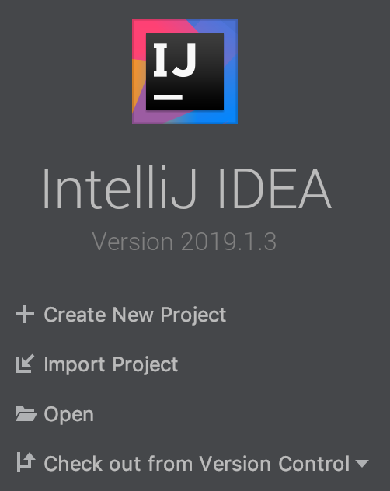
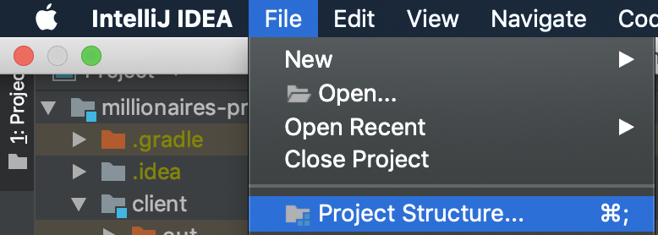
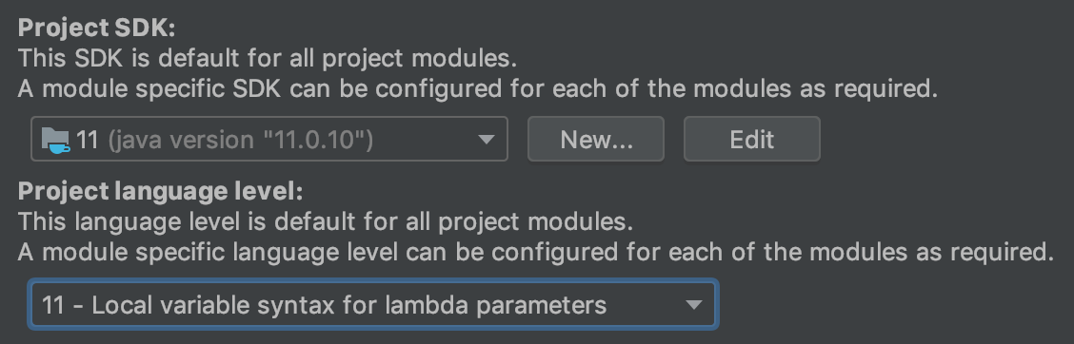
Building the Conclave Project
Start by opening IntelliJ, clicking “Open” and navigating to the directory that you previously downloaded from Git.
Next, lets check the Java version being used to compile the project and make sure we are using Java 11.
Navigate to “File” and then “Project Structure” as seen on the right.
Then take a look at the “Project SDK” section and confirm that you are setup to use Java 11.
Notes:
Architecture: Nodes, Notaries, Doorman Service and Oracles
UTXO Model Transactions, States and Flows
Business Networks and interoperability
Deployment and Hosting: on-prem vs. Cloud, (Azure, AWS, HP)
Security: Cryptography and immutability of records, P2P architecture
Performance considerations: Transactions per second, Consensus algorithms and Number of nodes per flow
Technology: Java, Kotline, JVM, AMQP over TLS, Pluggable databases

Slide 18
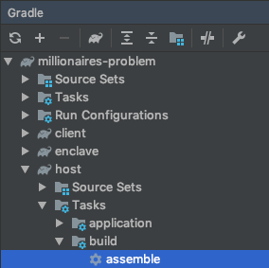
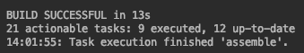
Building the Conclave Project
Before we dive into any source code, we will simply build the project and deploy it.
Navigate to the Gradle side panel and double click the “assemble” task as seen in the bottom right.
Make sure that you are using the correct “assemble” task, located under “host”.
This may take a few seconds to build and if it is successful you should see a message similar to the one below.
Notes:
Architecture: Nodes, Notaries, Doorman Service and Oracles
UTXO Model Transactions, States and Flows
Business Networks and interoperability
Deployment and Hosting: on-prem vs. Cloud, (Azure, AWS, HP)
Security: Cryptography and immutability of records, P2P architecture
Performance considerations: Transactions per second, Consensus algorithms and Number of nodes per flow
Technology: Java, Kotline, JVM, AMQP over TLS, Pluggable databases

Slide 19
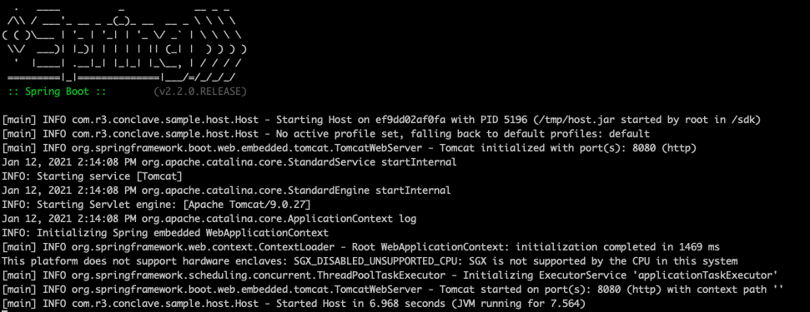
Deploy Conclave to the Docker Container
Once our project has finished the build, we can copy our project into the docker container.
Starting from the root of your project, run the following commands from your Terminal window.
docker cp host/build/libs/host.jar millionaires-problem:/tmp/host.jar
This will copy the build file onto the Docker container.
docker exec -ti millionaires-problem java -jar /tmp/host.jar
This will start your host & enclave.
If your machine looks similar to the snippet below, you have successfully deployed your first enclave!
Notes:
Architecture: Nodes, Notaries, Doorman Service and Oracles
UTXO Model Transactions, States and Flows
Business Networks and interoperability
Deployment and Hosting: on-prem vs. Cloud, (Azure, AWS, HP)
Security: Cryptography and immutability of records, P2P architecture
Performance considerations: Transactions per second, Consensus algorithms and Number of nodes per flow
Technology: Java, Kotline, JVM, AMQP over TLS, Pluggable databases

Slide 20
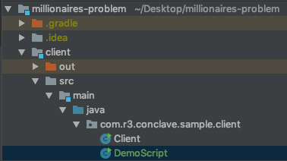
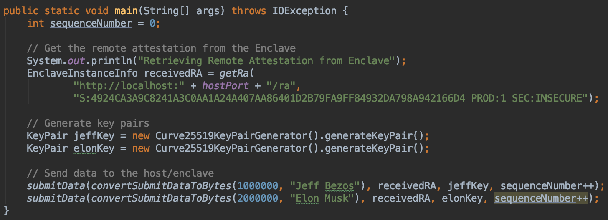
Running the Demo Script
Within IntelliJ, navigate to the DemoScript file in the client module as seen on the right.
You should find a class with a main() method like seen below.
For simplicity, we will be running each client from the same Java process.
When we run this script, the following things will happen.
We will retrieve a remote attestation from the Enclave
We will generate key pairs for both Jeff & Elon
Both Jeff & Elon will submit their net worth to the Enclave
The Enclave will output which millionaires net worth is higher (Elon)
Notes:
Architecture: Nodes, Notaries, Doorman Service and Oracles
UTXO Model Transactions, States and Flows
Business Networks and interoperability
Deployment and Hosting: on-prem vs. Cloud, (Azure, AWS, HP)
Security: Cryptography and immutability of records, P2P architecture
Performance considerations: Transactions per second, Consensus algorithms and Number of nodes per flow
Technology: Java, Kotline, JVM, AMQP over TLS, Pluggable databases

Slide 21
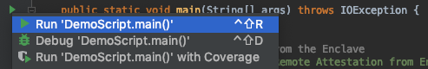
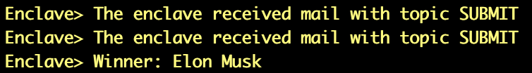
Running the Demo Script
Now that we understand the expected behavior, lets run the script by clicking the green arrow to the left of the main() method.
If you navigate to the terminal window where you deployed your Docker container, you should see output similar to the snippet below.
While it might not seem like much, … Congrats! You have successfully deployed and ran your first Conclave Application.
Notes:
Architecture: Nodes, Notaries, Doorman Service and Oracles
UTXO Model Transactions, States and Flows
Business Networks and interoperability
Deployment and Hosting: on-prem vs. Cloud, (Azure, AWS, HP)
Security: Cryptography and immutability of records, P2P architecture
Performance considerations: Transactions per second, Consensus algorithms and Number of nodes per flow
Technology: Java, Kotline, JVM, AMQP over TLS, Pluggable databases

Slide 22
Redeploying the Application
If you attempt to run the DemoScript an additional time, you’ll notice the error below.
This is due to the fact that the Enclave will track the sequence numbers of messages as a security measure to ensure the host isn’t attempting any malicious message reordering.
You’ll notice in DemoScript that the sequence number always starts at 0, causing the Enclave to fail if it is run multiple times.
While sequence numbers are a good concept to be aware of, we won’t be exploring it in detail in this tutorial.
Each additional time you want to run the DemoScript, simply stop the Enclave with Ctrl-C and then start the host JAR again.
If you are making changes to the source code, you will also want to rebuild the project and copy it back into the Docker container.
In the next slide we will review what is happening in more detail under the hood with our testing infrastructure.
Notes:
Architecture: Nodes, Notaries, Doorman Service and Oracles
UTXO Model Transactions, States and Flows
Business Networks and interoperability
Deployment and Hosting: on-prem vs. Cloud, (Azure, AWS, HP)
Security: Cryptography and immutability of records, P2P architecture
Performance considerations: Transactions per second, Consensus algorithms and Number of nodes per flow
Technology: Java, Kotline, JVM, AMQP over TLS, Pluggable databases

Slide 23
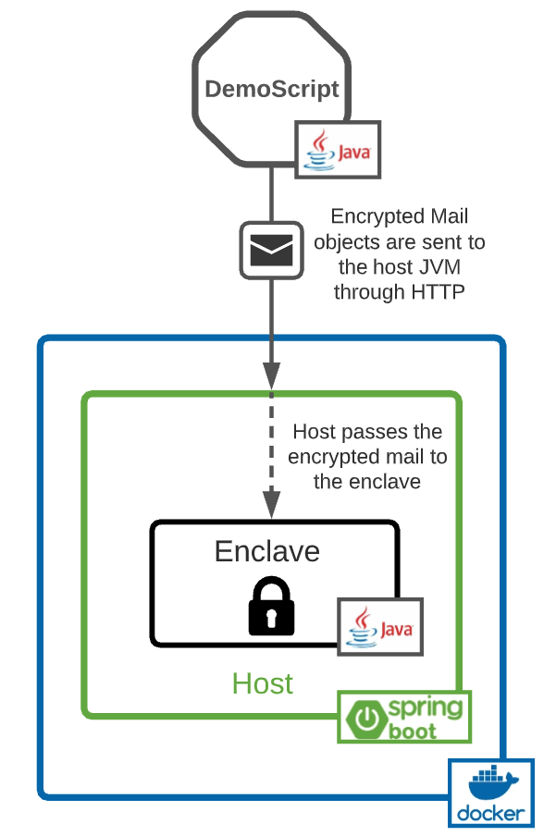
Deployment Architecture
On the right, we have our deployment architecture for this Conclave application.
We have both clients (Jeff & Elon) who submit encrypted data when we run a simple Java process.
In a production use case, Jeff and Elon would obviously submit data from their own respective machines.
In this example, the host simply passes the data to the enclave where it can be decrypted.
This isn’t the only way to build Conclave applications.
It’s possible to send data to an enclave through a variety of means including sockets or message queues.
Notes:
Architecture: Nodes, Notaries, Doorman Service and Oracles
UTXO Model Transactions, States and Flows
Business Networks and interoperability
Deployment and Hosting: on-prem vs. Cloud, (Azure, AWS, HP)
Security: Cryptography and immutability of records, P2P architecture
Performance considerations: Transactions per second, Consensus algorithms and Number of nodes per flow
Technology: Java, Kotline, JVM, AMQP over TLS, Pluggable databases

Slide 24
Source Code Review
4

Slide 25
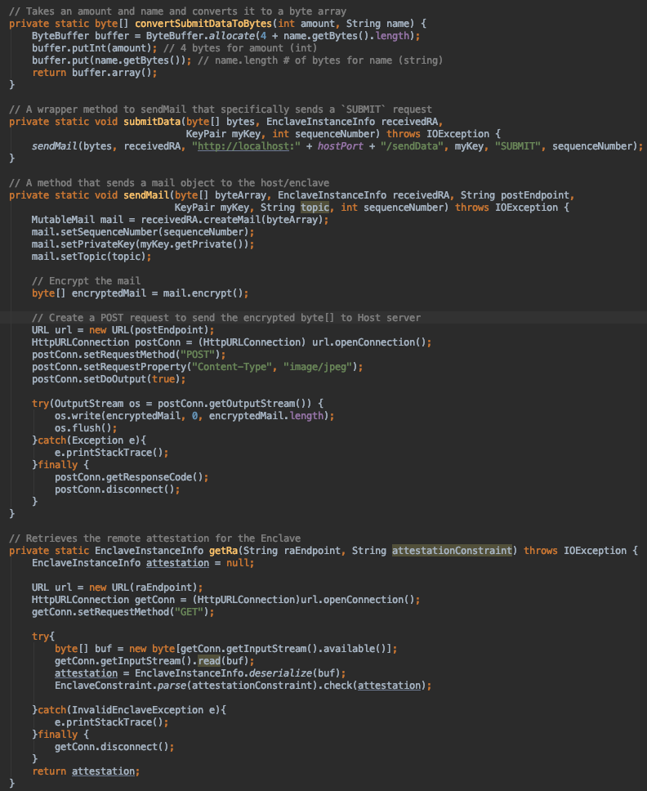
DemoScript
Let’s quickly review the remainder of the DemoScript which contains a few helper methods for sending data to the Host & Enclave.
convertSubmitDataToBytes() will simply take an amount and String and convert that to an array of bytes.
sendMail() sends a POST request containing a mail object to the host.
submitData() is a wrapper method for sendMail() that sends a mail with a topic of “SUBMIT”.
getRa() does a GET request to retrieve the remote attestation from the enclave.
Notes:
Architecture: Nodes, Notaries, Doorman Service and Oracles
UTXO Model Transactions, States and Flows
Business Networks and interoperability
Deployment and Hosting: on-prem vs. Cloud, (Azure, AWS, HP)
Security: Cryptography and immutability of records, P2P architecture
Performance considerations: Transactions per second, Consensus algorithms and Number of nodes per flow
Technology: Java, Kotline, JVM, AMQP over TLS, Pluggable databases

Slide 26
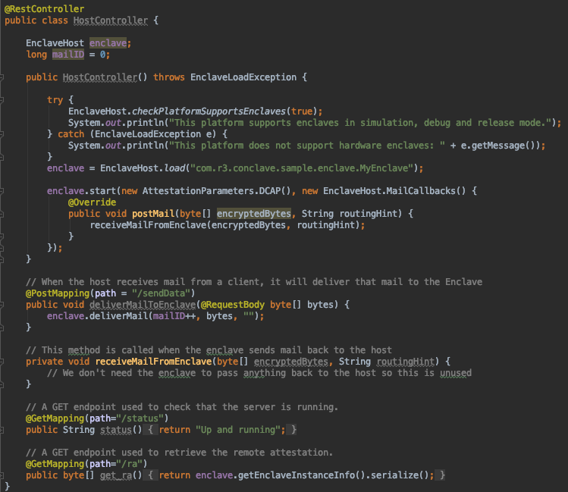
HostController
Next, lets move onto the HostController.
HostController() is run when we start up our Docker container. This will check that the platform supports running Enclaves before loading the enclave itself.
deliverMailToEnclave() is run when we send data from the client to the host. The host simply passes the bytes directly to the Enclave.
Notes:
Architecture: Nodes, Notaries, Doorman Service and Oracles
UTXO Model Transactions, States and Flows
Business Networks and interoperability
Deployment and Hosting: on-prem vs. Cloud, (Azure, AWS, HP)
Security: Cryptography and immutability of records, P2P architecture
Performance considerations: Transactions per second, Consensus algorithms and Number of nodes per flow
Technology: Java, Kotline, JVM, AMQP over TLS, Pluggable databases

Slide 27
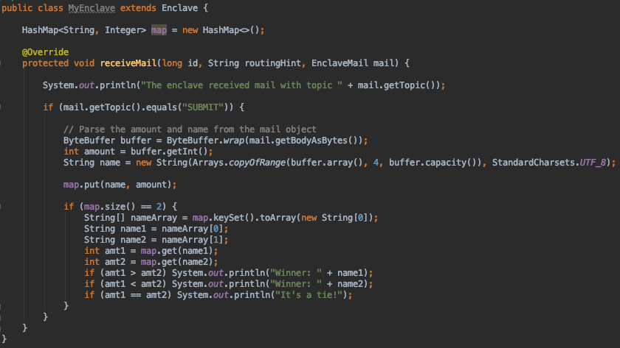
MyEnclave
Last but definitely not least, we have our enclave.
When the host sends data to the enclave, receiveMail() will process the data being sent.
If the topic is of type ”SUBMIT” we will convert the mail object back to an array of bytes and then parse those bytes into the amount and name.
Then we store that data in a HashMap for future use.
If the HashMap contains two entries, we will print out the name of the client with the larger net worth.
Notes:
Architecture: Nodes, Notaries, Doorman Service and Oracles
UTXO Model Transactions, States and Flows
Business Networks and interoperability
Deployment and Hosting: on-prem vs. Cloud, (Azure, AWS, HP)
Security: Cryptography and immutability of records, P2P architecture
Performance considerations: Transactions per second, Consensus algorithms and Number of nodes per flow
Technology: Java, Kotline, JVM, AMQP over TLS, Pluggable databases

Slide 28
Lab
5

Slide 29
Task #1: Multiparty Millionaires Problem
For our first task, we will be expanding the current functionality of this application so that many millionaires can submit data.
Every time a client submits data regardless of the number of submissions, print out the client with the largest wealth.
You’ll also want to add one additional millionaire (it could even be you!) to the DemoScript.
To test your changes, you will need to rebuild the application, copy it back onto the Docker container and restart the host & enclave as we did previously.
Hints!
All required changes should happen within MyEnclave & DemoScript.
There may already be a provided method that you can utilize…
Notes:
Architecture: Nodes, Notaries, Doorman Service and Oracles
UTXO Model Transactions, States and Flows
Business Networks and interoperability
Deployment and Hosting: on-prem vs. Cloud, (Azure, AWS, HP)
Security: Cryptography and immutability of records, P2P architecture
Performance considerations: Transactions per second, Consensus algorithms and Number of nodes per flow
Technology: Java, Kotline, JVM, AMQP over TLS, Pluggable databases

Slide 30
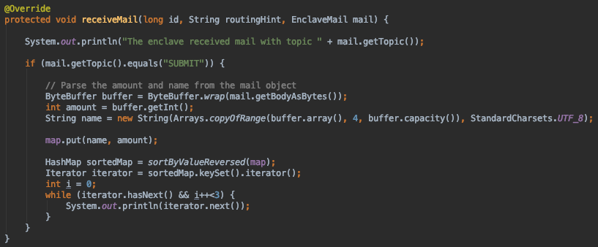
Task #1: Multiparty Millionaires Problem (Solution)
While your individual solution may look different, below is an example solution.
Notes:
Architecture: Nodes, Notaries, Doorman Service and Oracles
UTXO Model Transactions, States and Flows
Business Networks and interoperability
Deployment and Hosting: on-prem vs. Cloud, (Azure, AWS, HP)
Security: Cryptography and immutability of records, P2P architecture
Performance considerations: Transactions per second, Consensus algorithms and Number of nodes per flow
Technology: Java, Kotline, JVM, AMQP over TLS, Pluggable databases

Slide 31
Task #2: Add Functionality for Removing an Entry
Now that several millionaires can submit data to the enclave, we are going to add additional functionality so that they can remove their data if desirable.
For now, lets assume there are no bad actors and Elon won’t attempt to remove Jeff’s entry for example.
There is no need to reprint the client list after removing an entry.
You’ll want to modify MyEnclave so it will accept mails with the topic of “REMOVE” that only contain the client’s name.
To test your changes, you’ll need to rebuild and redeploy the enclave as covered previously.
Hints!
You don’t need to create any new endpoints or make any changes in the HostController.
You’ll likely want to create a new wrapper method in DemoScript for removing data.
Enter a sequence number of 0 when submitting the REMOVE request. The sequence number is specific to the topic so you will want to create another counter or just use 0.
Notes:
Architecture: Nodes, Notaries, Doorman Service and Oracles
UTXO Model Transactions, States and Flows
Business Networks and interoperability
Deployment and Hosting: on-prem vs. Cloud, (Azure, AWS, HP)
Security: Cryptography and immutability of records, P2P architecture
Performance considerations: Transactions per second, Consensus algorithms and Number of nodes per flow
Technology: Java, Kotline, JVM, AMQP over TLS, Pluggable databases

Slide 32
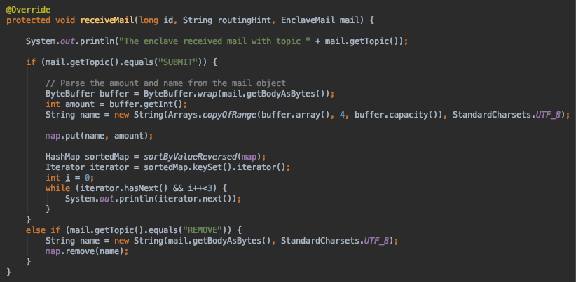
Task #2: Add Functionality for Removing an Entry (Solution)
While your individual solution may look different, below is an example solution.
DemoScript
MyEnclave
Notes:
Architecture: Nodes, Notaries, Doorman Service and Oracles
UTXO Model Transactions, States and Flows
Business Networks and interoperability
Deployment and Hosting: on-prem vs. Cloud, (Azure, AWS, HP)
Security: Cryptography and immutability of records, P2P architecture
Performance considerations: Transactions per second, Consensus algorithms and Number of nodes per flow
Technology: Java, Kotline, JVM, AMQP over TLS, Pluggable databases

Slide 33
Wrap Up
Congrats!! You now should have a basic understanding of how to develop Conclave Applications.
While there definitely is a lot more to Conclave than just what is covered here, this is a great start to better understanding Conclave and confidential computing as a whole.
More information on Conclave can be found using the links below.
Conclave Website: https://www.r3.com/platform-conclave/
Conclave Docs: https://docs.conclave.net/
Conclave CordaCon Presentation: https://www.youtube.com/watch?v=hwBnDEab48A
Notes:
Architecture: Nodes, Notaries, Doorman Service and Oracles
UTXO Model Transactions, States and Flows
Business Networks and interoperability
Deployment and Hosting: on-prem vs. Cloud, (Azure, AWS, HP)
Security: Cryptography and immutability of records, P2P architecture
Performance considerations: Transactions per second, Consensus algorithms and Number of nodes per flow
Technology: Java, Kotline, JVM, AMQP over TLS, Pluggable databases

